Slide 1
Data Warehouse Indexes
Glenda Gable
Email: ggable@sql313.com
Blog: sql313.com
LinkedIn: linkedin.com/in/tig313

Slide 2
Agenda
What is an Index?
Ultimate Goal of an Index
What is the point of a data warehouse?
OLTP vs OLAP
Indexing Dimension Tables
Indexing Fact Tables – Detail
Indexing Fact Tables – Summary
Columnstore Indexes
What Indexes should you have?
Other considerations
Index Maintenance
Tip and a Script
Resources
Grab your coffee, sit back and lets go…
Notes:
We are going to talk about indexes in general, then data warehouses in general, and finally how they can relate to each other.

Slide 3
What is an Index?
It’s a way to speed up searching for data in a database, which can help with performance – sometimes good and sometimes bad.
It should be able to operate with other indexes to filter out the records before accessing raw data.
It should be as
small as possible
and utilize space
efficiently.

Slide 4
Comparison
Indexes do not affect the data returned - The same results are returned regardless of Indexes.
WITH INDEXES |  | WITHOUT INDEXES
Faster | Query Response Time | Slower
Slower | Data Load Time | Faster
Seeks | Method for Querying Data | Scans
More | Storage Space Needed | Less

Slide 5
Ultimate GOAL of an Index
REDUCE THE NUMBER OF HOPS IT TAKES TO BRING BACK YOUR RESULTS, AS QUICKLY AS POSSIBLE
Notes:
Hence the frogs… ☺

Slide 6
What is the point of a Data warehouse?
Reporting
Single repository of data
integrated from multiple sources
Data consistency across multiple sources
Data Quality
Performance (vs. reporting from production)
Self-Service BI
Controlled Data Security
Archiving
Historical record of data and/or data changes

Slide 7
OLTP vs OLAP
Current data | Current and Historical data
Simple, known queries | Complex, ad hoc, and aggregate queries
Small recordsets | Large recordsets
Short transactions | Long transactions
Insert/Update/Select | Select (read-only)
Real-time updates | Batch updates
Unique index | Multiple indexes
Detail data retrieval | Detail and Aggregated data retrieval
Low I/O or Memory processing | High I/O or Memory processing
Response time does not depend on database size | Response time does depend on database size
Notes:
Online Transaction Processing
Online Analytical Processing

Slide 8
These are guidelines
only
There are no “hard and fast” rules because when to use an index depends on how data is retrieved by queries.

Slide 9
Dimension Tables
Made up of descriptive attributes/fields
More text/string based
Used as Lookup values
Examples:
Product Name or Color
Product Classification/Group
Customer Name/Address
Date Hierarchy

Slide 10
Indexing Dimension Tables
This depends on how the data is stored.
1 Clustered Primary Key Index
If a clustered primary key exists, it is recommended by some to use that primary key in other tables as the foreign key, instead of the natural business key.
1 Non Clustered Index on the Natural Business Key
Non Clustered Indexes on the foreign keys (single index for each)
Notes:
In his book, The Data Warehouse ETL Toolkit, Ralph Kimball discusses the creation of a surrogate key within the ETL process. Thereby not relying on the natural business key. If a surrogate key is made, it is recommended to be an integer based, which makes it perfect to use as a clustered primary key index. The book explains reasons for this, mainly the dependency on the source system to be consistent, multiple source systems may have the same values, data types, and more.
If this clustered primary key exists, there are a lot of people who would also recommend that the primary key be stored as a foreign key in associated tables, rather than the natural business key.
Another useful index would be a non clustered index on the natural business key, if it is used in any reporting or analysis. This is not a given, but if queries use it, it might be helpful.
Lastly, having a single index for each, appropriate, foreign key, can help improve performance as well.

Slide 11
Fact Tables
Made up of measurements or metrics of dimensions
Can be Detail or Summary tables – mostly depending on the analytical software used
Examples:
Count of Products Ordered by Customer/Date/State
Count of Products sold by Supplier/Date/State
Count of natural disasters by Type/Date/Country/State
Notes:
If using SSAS, cubes will be built from Detail tables.
However, if using another third-party software, such as MicroStrategy, or other analytical software, they might want Summary tables and Detail tables. Specifically, for MicroStrategy, if you have one summary table that is aggregated by day, and another by month, it is smart enough to know, depending on the data being returned, which table will give the fastest results and uses it.

Slide 12
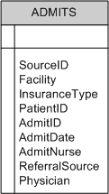
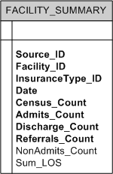
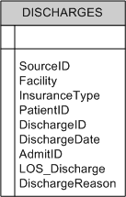
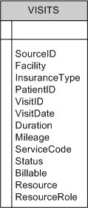
Fact Tables - Example of - Detail vs Summary

Slide 13
Indexing Fact Tables - Detail tables
Start with the Date column
Whichever key is used as a foreign key in other tables can be beneficial
Included columns are
good to use along with the date or key
If a table is partioned, add a single-column index to the date key on the partition
Notes:
Most Fact tables are going to have the date dimension included, as most analytics are for a time range of some kind.
Therefore, the date key is the starting place for planning indexes.
For detail tables, it may be as easy as the date and the natural business key, or other columns, singly used in an index.

Slide 14
Indexing Fact Tables - Summary tables
Just as with the detail tables, start with the Date column
A lot of times you will have an index with the Date column and 1 aggregated column – but not all aggregated columns need an index
The summary tables will be queried differently than the detail tables – so check the query plans to see what would be best

Slide 15
Indexing Staging tables
Will the data be used
more than once?
How is it loaded –
truncated/repopulated, updated, etc.
Foreign-key indexes to help maintain referential integrity are probably not going to do much except for slow things down
Heaps arent SO bad
Notes:
If the table will be queried once only during the ETL process, after the initial load, will it really save time to have an index on it? Alternatively, if a table is used multiple times, an index may help dramatically. Consider: Lets say you have a query that returns results in 2 mins. If it takes 15 seconds to add an index, but it only saves you 50% of the time – is that really worth it? On the other hand, if it takes 2 mins to index the table, but that table is used multiple times and the savings is 10 mins – that might be worth it.
A lot of the foreign-key integrity is completed during the ETL process and therefore isnt as necessary for a staging warehouse environment – you may not need to repeat it. It may take longer to rebuild the indexes than what it is worth.
When the table has data inserted, and then queried as-is, without any updates at all, then heaps may be faster. This requires testing to confirm though – not just to be done without specifically wanting it to be that way. Heaps shouldn’t be there just because its easiest to make.

Slide 16
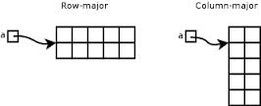
Columnstore Indexes
Columnstore indexes group by column, rather than the traditional row-based indexes.
Came to be due to BI/data warehousing/bulk data needs
The columnstore index must be dropped or disabled in order to load data into the table

Slide 17
Columnstore Indexes
The following is from Microsoft technet:
Some of the performance benefit of a columnstore index is derived from the compression techniques that reduce the number of data pages that must be read and manipulated to process the query. Compression works best on character or numeric columns that have large amounts of duplicated values.
Examples:
Sales Regions/States
Dates

Slide 18
What indexes should you have?
SQL Server Standard Reports
In SSMS, right click on your database
Mouse over “Reports” then “Standard Reports”
“Index Physical Statistics”
“Disk Usage by Top Tables”
Brent Ozar – sp_BlitzIndex
http://www.brentozar.com/blitzindex/
Jason Strate – Codeplex
http://indexanalysis.codeplex.com/
Denny Cherry – Redmond Magazine
http://redmondmag.com/articles/2014/04/11/new-sql-server-indexes.aspx
MSDB – Analyzing a Query
http://msdn.microsoft.com/en-us/library/ms191227.aspx
Notes:
This is a BIG topic!
Finding out what indexes you should have, or already have and how they are being used works exactly the same for OLTP and OLAP databases. There are a LOT of resources online. The slide shows a few resources to help find more info.
Brent Ozar’s link has a video to step you through how to use the script and explains it fully. The script itself includes a lot of helpful information, including giving you links back to the ozar website for further information about each “find” returned in the results.
I have singled it out here mostly because I have used it and it really helped teach me about indexes to begin with. I was clueless, and when I ran it I felt like I understood what was going on (of course, whether I did or not is a different story). ☺

Slide 19
Other Guidelines
Check the query plans to see how tables are being queried
Disable or Drop indexes before insert/updates, then rebuild them afterwards
If you disable your index, rather than drop it, the definition of the index and the statistics will be retained.
Don’t forget about Index Maintenance when planning initially
If a clustered primary key is used – and if the data is truncated and reinserted - try to order the data going into the table in the same way the clustered index would do so to fill the pages in sequence
Monitor your index strategy – query needs change, and your indexes should adjust!

Slide 20
Index Maintenance
Ola Hallengren
Ola’s Maintenance Solution has won multiple awards and is very widely used in the SQL Server community. http://ola.hallengren.com/sql-server-index-and-statistics-maintenance.html
Michelle Ufford
http://sqlfool.com/2011/06/index-defrag-script-v4-1
Tara Kizer
http://weblogs.sqlteam.com/tarad/archive/2009/11/03/DefragmentingRebuilding-Indexes-in-SQL-Server-2005-and-2008Again.aspx
Merrill Aldrich
http://sqlblog.com/blogs/merrill_aldrich/archive/2012/08/01/rules-driven-maintenance.aspx
Redgate - SQL Index Manager
http://www.red-gate.com/products/dba/sql-index-manager/
Notes:
“Ola’s are the gold standard and allow you to do backups, index and statistics maintenance, and consistency checks.” by Paul Randal
http://www.sqlskills.com/blogs/paul/easy-automation-of-sql-server-database-maintenance/

Slide 21
Tip …
If you disable the Clustered Index, it automatically disables all the NonClustered Indexes also
Process looks like:

Slide 22
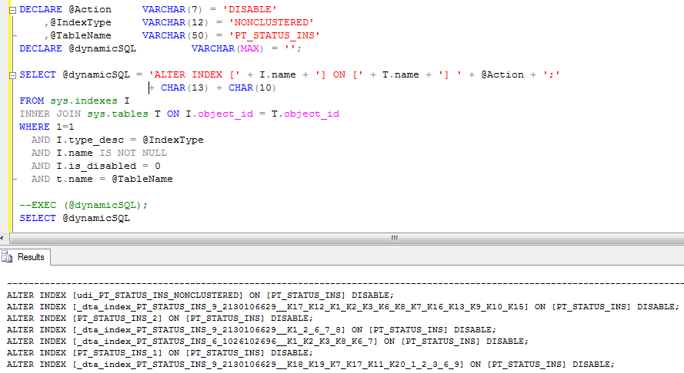
… and a Script
Located at… http://sql313.com

Slide 23
Resources
SQL Server Pro
http://sqlmag.com/sql-server-analysis-services/indexing-data-warehouse
Jen Stirrup
http://www.jenstirrup.com/2010/07/indexing-fact-and-dimension-guidelines.html
Columnstore Indexes
http://technet.microsoft.com/en-us/library/gg492088.aspx
The Data Warehouse ETL Toolkit
Authors: Kimball, Caserta
Professional SQL Server 2012
Administration
Authors: Jorgensen, Wort, LoForte, Knight

Slide 24
Questions
Email: ggable@sql313.com
Blog: sql313.com
LinkedIn: linkedin.com/in/tig313

